Slide 1
Echo Yang

Slide 2
2025 EOY Bonus

Slide 3
Bonus
Bonus Depends on company results & your results
2025 sales were down vs. 2024 and vs. our target.
However, we did a better job of managing our costs and improved our profitability.
Flyers can receive up to 100% of their bonus.
Your 2025 Bonus Potential
RMB 1,029 1 Months
Your 2025 Actual Bonus
RMB 2,012 8 Months 4% of Potential

Slide 4
2026

Slide 5
2026 Salary
Current Salary
RMB 3,022 Per month
2026 Salary
RMB 4,075 Per month
Merit Increase %
4 %
2026 Bonus Potential
RMB 5,047 0 Months

Slide 6
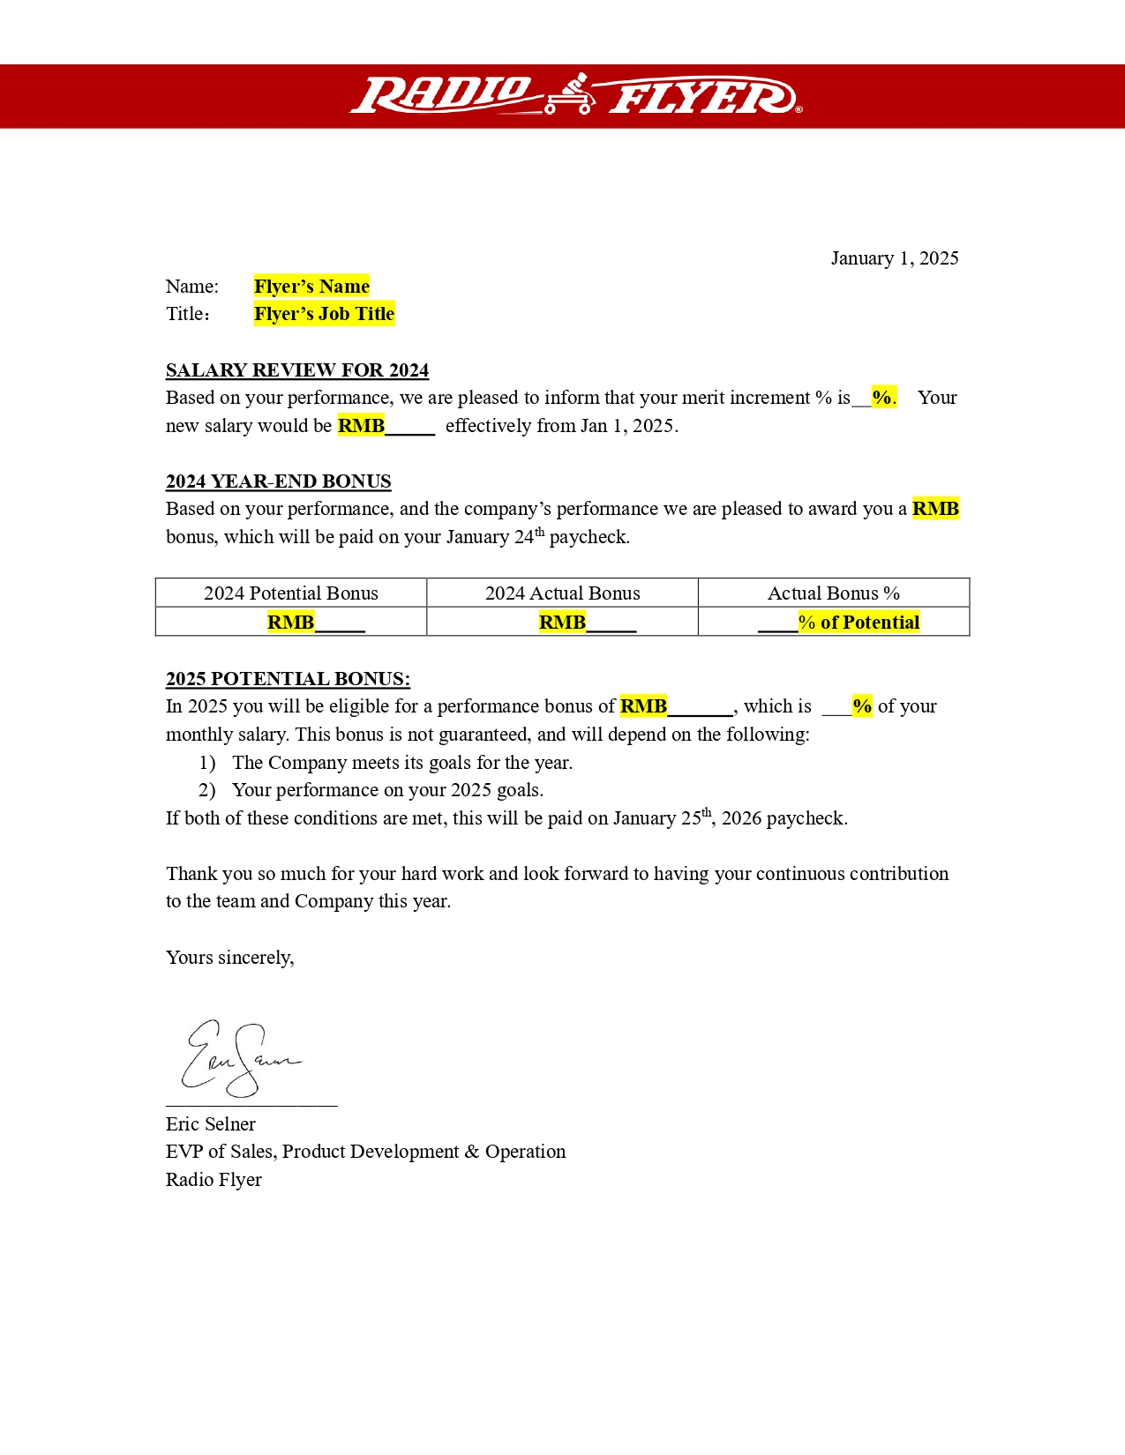
Image: Flyer’s salary letter

Slide 8
Anita Zheng

Slide 9
2025 EOY Bonus

Slide 10
Bonus
Bonus Depends on company results & your results
2025 sales were down vs. 2024 and vs. our target.
However, we did a better job of managing our costs and improved our profitability.
Flyers can receive up to 100% of their bonus.
Your 2025 Bonus Potential
RMB 1,046 9 Months
Your 2025 Actual Bonus
RMB 2,086 6 Months 4% of Potential

Slide 11
2026

Slide 12
2026 Salary
Current Salary
RMB 3,013 Per month
2026 Salary
RMB 4,056 Per month
Merit Increase %
7 %
2026 Bonus Potential
RMB 5,002 6 Months

Slide 13
Image: Flyer’s salary letter

Slide 15
Abby Qi

Slide 16
2025 EOY Bonus

Slide 17
Bonus
Bonus Depends on company results & your results
2025 sales were down vs. 2024 and vs. our target.
However, we did a better job of managing our costs and improved our profitability.
Flyers can receive up to 100% of their bonus.
Your 2025 Bonus Potential
RMB 1,058 2 Months
Your 2025 Actual Bonus
RMB 2,067 7 Months 7% of Potential

Slide 18
2026

Slide 19
2026 Salary
Current Salary
RMB 3,034 Per month
2026 Salary
RMB 4,098 Per month
Merit Increase %
7 %
2026 Bonus Potential
RMB 5,007 3 Months

Slide 20
Image: Flyer’s salary letter

Slide 22
Lily Li

Slide 23
2025 EOY Bonus

Slide 24
Bonus
Bonus Depends on company results & your results
2025 sales were down vs. 2024 and vs. our target.
However, we did a better job of managing our costs and improved our profitability.
Flyers can receive up to 100% of their bonus.
Your 2025 Bonus Potential
RMB 1,021 7 Months
Your 2025 Actual Bonus
RMB 2,017 6 Months 3% of Potential

Slide 25
2026

Slide 26
2026 Salary
Current Salary
RMB 3,082 Per month
2026 Salary
RMB 4,052 Per month
Merit Increase %
1 %
2026 Bonus Potential
RMB 5,079 5 Months

Slide 27
Image: Flyer’s salary letter

Slide 29
Emily Peng

Slide 30
2025 EOY Bonus

Slide 31
Bonus
Bonus Depends on company results & your results
2025 sales were down vs. 2024 and vs. our target.
However, we did a better job of managing our costs and improved our profitability.
Flyers can receive up to 100% of their bonus.
Your 2025 Bonus Potential
RMB 1,053 6 Months
Your 2025 Actual Bonus
RMB 2,023 7 Months 4% of Potential

Slide 32
2026

Slide 33
2026 Salary
Current Salary
RMB 3,022 Per month
2026 Salary
RMB 4,082 Per month
Merit Increase %
2 %
2026 Bonus Potential
RMB 5,003 9 Months

Slide 34
Image: Flyer’s salary letter

Slide 36
Sylvia Liu

Slide 37
2025 EOY Bonus

Slide 38
Bonus
Bonus Depends on company results & your results
2025 sales were down vs. 2024 and vs. our target.
However, we did a better job of managing our costs and improved our profitability.
Flyers can receive up to 100% of their bonus.
Your 2025 Bonus Potential
RMB 1,050 8 Months
Your 2025 Actual Bonus
RMB 2,086 0 Months 5% of Potential

Slide 39
2026

Slide 40
2026 Salary
Current Salary
RMB 3,047 Per month
2026 Salary
RMB 4,005 Per month
Merit Increase %
1 %
2026 Bonus Potential
RMB 5,019 9 Months

Slide 41
Image: Flyer’s salary letter

Slide 43
Jane Chen

Slide 44
2025 EOY Bonus

Slide 45
Bonus
Bonus Depends on company results & your results
2025 sales were down vs. 2024 and vs. our target.
However, we did a better job of managing our costs and improved our profitability.
Flyers can receive up to 100% of their bonus.
Your 2025 Bonus Potential
RMB 1,040 5 Months
Your 2025 Actual Bonus
RMB 2,020 7 Months 5% of Potential

Slide 46
2026

Slide 47
2026 Salary
Current Salary
RMB 3,075 Per month
2026 Salary
RMB 4,016 Per month
Merit Increase %
1 %
2026 Bonus Potential
RMB 5,093 7 Months

Slide 48
Image: Flyer’s salary letter

Slide 50
Lyn Zhou

Slide 51
2025 EOY Bonus

Slide 52
Bonus
Bonus Depends on company results & your results
2025 sales were down vs. 2024 and vs. our target.
However, we did a better job of managing our costs and improved our profitability.
Flyers can receive up to 100% of their bonus.
Your 2025 Bonus Potential
RMB 1,055 7 Months
Your 2025 Actual Bonus
RMB 2,075 8 Months 7% of Potential

Slide 53
2026

Slide 54
2026 Salary
Current Salary
RMB 3,009 Per month
2026 Salary
RMB 4,014 Per month
Merit Increase %
3 %
2026 Bonus Potential
RMB 5,096 6 Months

Slide 55
Image: Flyer’s salary letter

Slide 57
Carrie Liu

Slide 58
2025 EOY Bonus

Slide 59
Bonus
Bonus Depends on company results & your results
2025 sales were down vs. 2024 and vs. our target.
However, we did a better job of managing our costs and improved our profitability.
Flyers can receive up to 100% of their bonus.
Your 2025 Bonus Potential
RMB 1,057 8 Months
Your 2025 Actual Bonus
RMB 2,029 9 Months 3% of Potential

Slide 60
2026

Slide 61
2026 Salary
Current Salary
RMB 3,070 Per month
2026 Salary
RMB 4,048 Per month
Merit Increase %
5 %
2026 Bonus Potential
RMB 5,027 2 Months

Slide 62
Image: Flyer’s salary letter

Slide 64
Rainbow Lin

Slide 65
2025 EOY Bonus

Slide 66
Bonus
Bonus Depends on company results & your results
2025 sales were down vs. 2024 and vs. our target.
However, we did a better job of managing our costs and improved our profitability.
Flyers can receive up to 100% of their bonus.
Your 2025 Bonus Potential
RMB 1,065 3 Months
Your 2025 Actual Bonus
RMB 2,069 1 Months 7% of Potential

Slide 67
2026

Slide 68
2026 Salary
Current Salary
RMB 3,078 Per month
2026 Salary
RMB 4,017 Per month
Merit Increase %
0 %
2026 Bonus Potential
RMB 5,040 3 Months

Slide 69
Image: Flyer’s salary letter

Slide 71
Vana Zheng

Slide 72
2025 EOY Bonus

Slide 73
Bonus
Bonus Depends on company results & your results
2025 sales were down vs. 2024 and vs. our target.
However, we did a better job of managing our costs and improved our profitability.
Flyers can receive up to 100% of their bonus.
Your 2025 Bonus Potential
RMB 1,077 0 Months
Your 2025 Actual Bonus
RMB 2,044 7 Months 2% of Potential

Slide 74
2026

Slide 75
2026 Salary
Current Salary
RMB 3,069 Per month
2026 Salary
RMB 4,098 Per month
Merit Increase %
8 %
2026 Bonus Potential
RMB 5,018 9 Months

Slide 76
Image: Flyer’s salary letter

